Slide 1
智能系统设计与应用 (2022 春季学期)
Case V:
Distributed Model Reuse:
FedPAN
主讲教师：詹德川

Slide 2
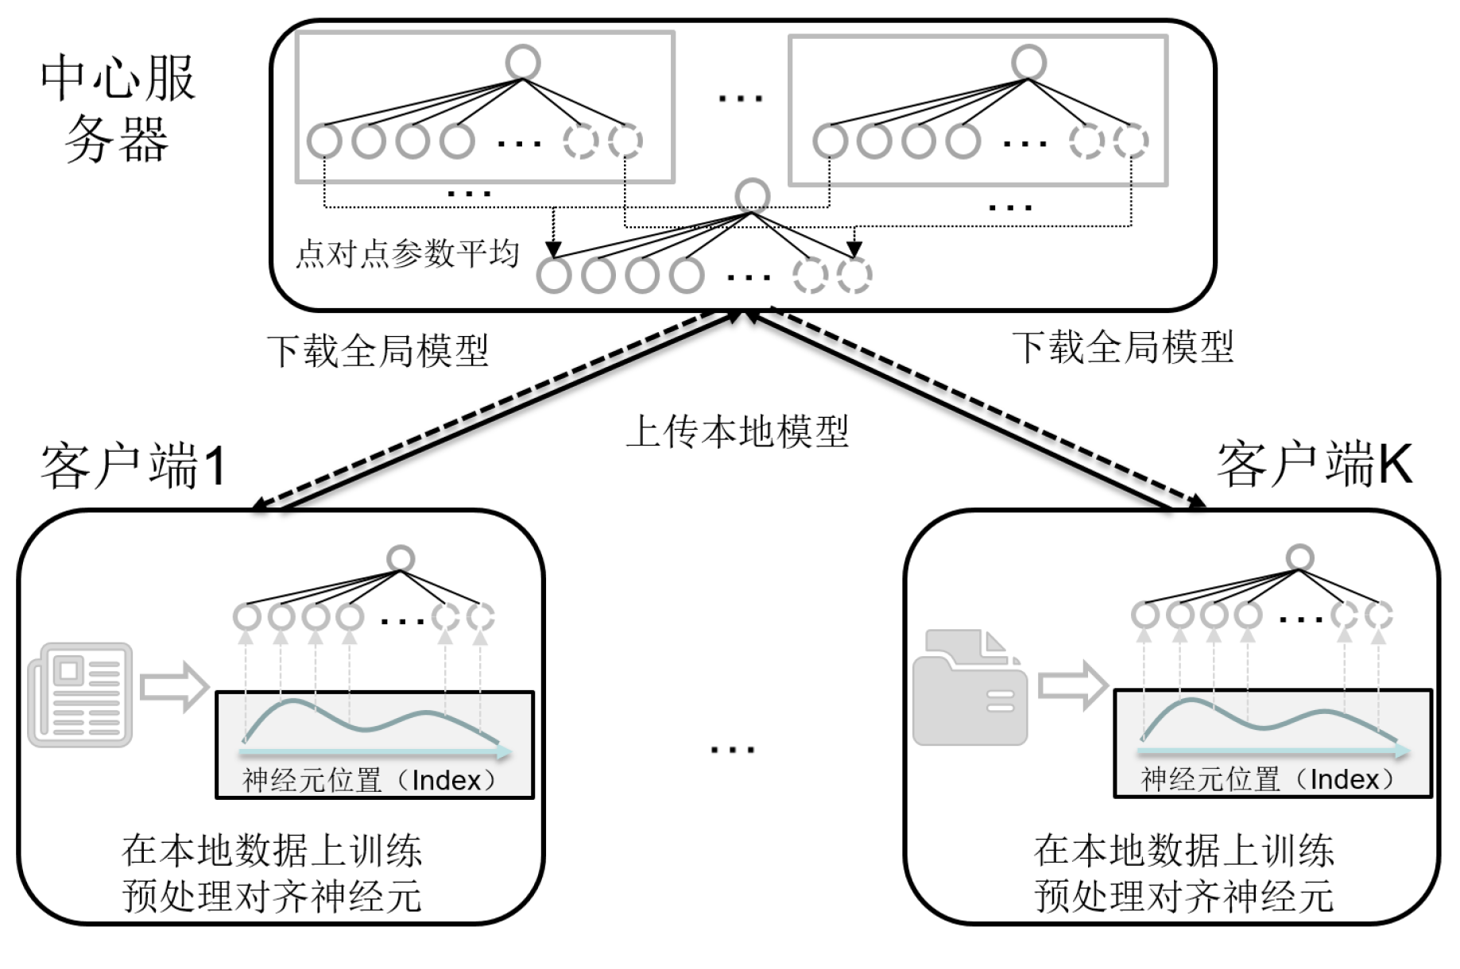
分布式训练+PANs
效果：本地训练神经元通过位置编码进行预对齐，在中心服务器即可进行有效点对点参数平均

Slide 3
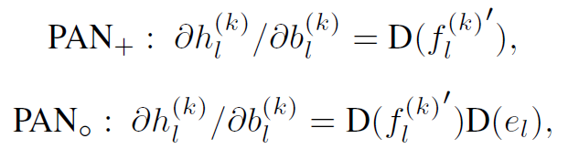
分布式训练+PANs
为什么带有位置编码的神经网络应用到分布式训练会有效：
直观解释：
PANs将神经元和其位置紧密关联，在异构数据情况下，局部模型的神经元会尽量避免错位现象，因为神经元错位之后会使得输出变化，从而导致训练误差变大以及训练不稳定
为了求稳，神经元不会错位
理论解释：
各个客户端前向训练过程有共同的成分，位置编码。梯度更新过程也有一致的成分，位置编码越强，梯度更新方向越一致
客户端共享信息：梯度正则化

Slide 4
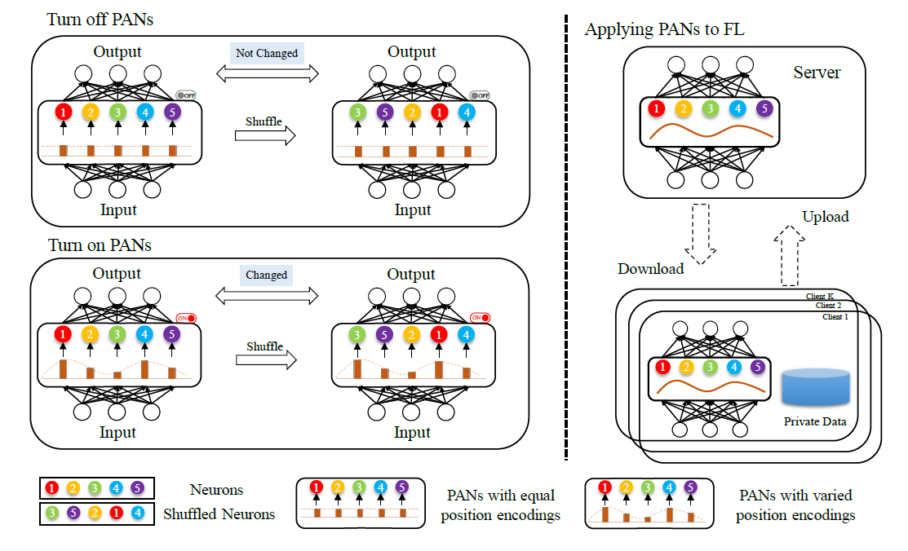
研发算法FedPAN
左图：提出“位置相关的神经元”(Position-Aware Neurons, PANs)，将其封装为一个“开关”：打开/关闭PANs，即可禁用/启用神经网络的重排不变性
右图：将PANs应用到分布式训练，客户端上预对齐特征

Slide 5
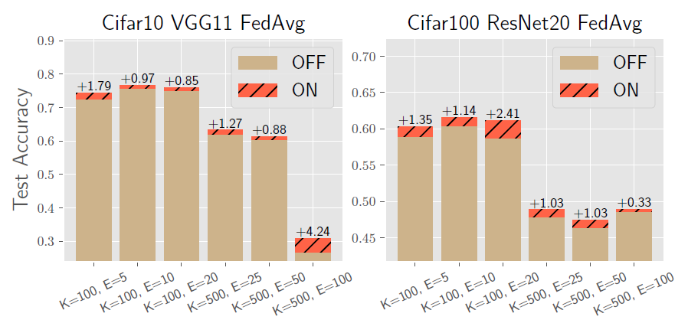
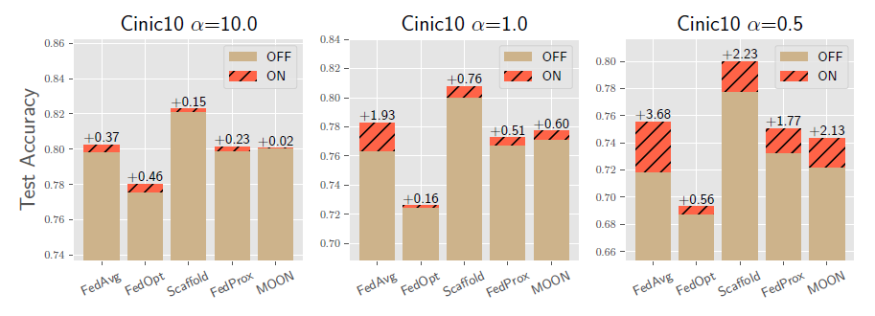
研发算法FedPAN
在多个数据集、多种设置下均可提升聚合模型的性能(红色部分)

Slide 6
目录
项目背景
痛点难点分析
现有解决方案
提出的解决方案
可扩展方向
技术落地应用

Slide 7
分布式模块化集成学习
深度网络模块化集成框架：将模型按照纵向、横向切分为多个模块，每个客户端只选择部分模块，如何切分？如何聚合？
有序/位置相关模型更容易划分
有序/位置相关模型更容易聚合
Server
如何聚合？
如何为每个客户端选择合适的模块？
Client A
Client B
Clients
学习有序/位置相关模型
异构数据
有序/位置相关模型
有序/位置相关特征

Slide 8
目录
项目背景
痛点难点分析
现有解决方案
提出的解决方案
可扩展方向
技术落地应用

Slide 9
技术落地应用
实际应用场景
多APP智能业务感知：根据流量包对APP类型进行识别，但是不能将用户流量包聚集到服务器训练（已验证）
ONT/OLT应用识别：对家庭光猫的用户流量进行应用识别，需根据以往模型构建新场景下的模型（待验证）
DC节能模型构建：节能模型随时间场景特异，需根据现有的节能模型推导出合适的新节点模型，减少成本（待验证）
隐私保护
数据异构
分布式模型重用
技术落地
技术研究深化：
研究基于位置编码的特征预对齐技术(已和华为合作申请专利 + CVPR 2022中稿)
研究基于有序/位置相关模型的分布式集成学习框架

Slide 10
多APP智能业务感知背景
智能业务感知(Service Awareness, SA)：
-- 通过机器学习从字节流中检测该流量来自的具体应用
问题描述：
单一局点上训练SA模型需要大量的数据支持
若要借助多方之间的数据进行合作，需要保护数据隐私
现有数据包括3个局点，SA目标分类是36分类
项目目标：
在数据隐私保护的条件下联合三方数据来提升SA模型的性能
SA机器学习问题抽象：
-- 从字节流中检测具体应用的过程使用CNN分类模型进行建模
X：字节流数据
大小为3 * 256
CNN

Slide 11
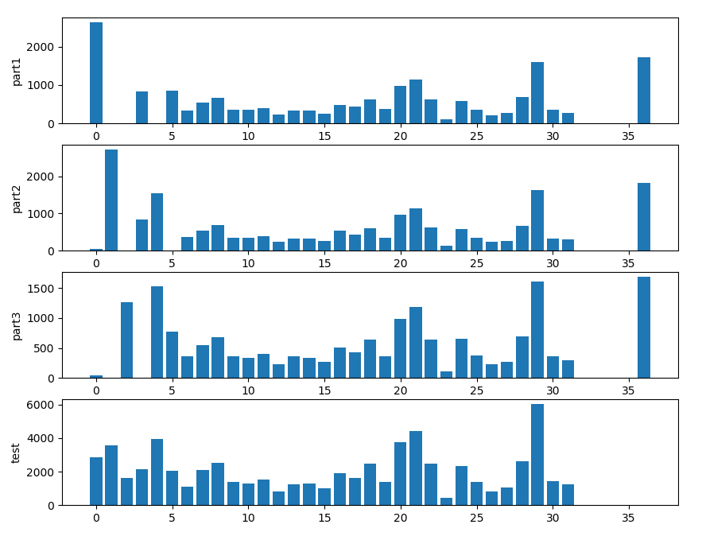
多APP智能业务感知难点
数据分布NonIID：
-- 标记分布差异
-- 特征分布差异
右图展示了三个局点的标记分布，以及全局测试集的标记分布，仅看标记分布就存在很大差异，个别局点上还会有缺失类别，导致直接应用FedAvg会出现模型参数点对点聚合不准的问题

Slide 12
SA卷积网络设计
SA卷积神经网络设计(非常重要)：
-- 卷积核的设计需要考虑信息流的存储方式
-- SA中信息按行存储，可以理解为3行256列
OR
1 * 3 * 256
1 * 1 * 3
3 * 1 * 256
3 * 1 * 3
Type A (效果更好)
Type B
Model | 参数量 | 运行时间 | 局点1 ACC | 局点2 ACC | 局点3 ACC | 数据集中ACC
Type A | 2, 037, 629 | 2.51h | 0.757 | 0.803 | 0.755 | 0.932
Type B | 726, 293 | 1.89h | 0.659 | 0.742 | 0.708 | 0.916

Slide 13
FedPAN应用效果
FedAvg | 局点1 ACC | 局点2 ACC | 局点3 ACC | 全局测试集ACC
E=5 | 0.836 | 0.834 | 0.836 | 0.837
E=10 | 0.815 | 0.819 | 0.816 | 0.824
FedPAN | 局点1 ACC | 局点2 ACC | 局点3 ACC | 全局测试集ACC
E=5 | 0.873 | 0.882 | 0.867 | 0.893
E=10 | 0.859 | 0.858 | 0.858 | 0.859
* E代表客户端本地迭代的轮次
验证结果分析：
由于数据异构，FedAvg使用点对点参数聚合的模型性能只有0.837
采用了FedPAN的结果可以达到0.893，拉近了与数据集中式训练的效果(0.932)的差距

Slide 14
智能系统设计与应用 (2022 春季学期)
Case VI:
How to Measure the Difference
主讲教师：詹德川

Slide 15

利用多视图信息进行度量学习
基于双视图关联距离度量的半监督学习
视图1
视图2
条件独立
该“相关空间”应当浓缩了和分类相关的信息
视图1
视图2
真实类别
相关性

Slide 16
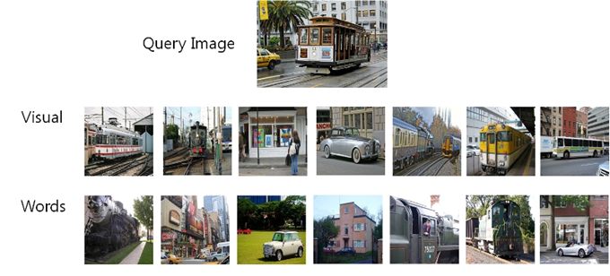
利用多视图信息进行度量学习
基于双视图关联距离度量的半监督学习
KCCA
KCCA寻找“相关性”大的空间
在此空间中定义距离度量
使用该距离度量扩充标记样本集
进行半监督学习Co-training

Slide 17
智能系统设计与应用 (2022 春季学期)
Case VII:
Fingerprints and/or Face?
Learning with Multi-Modalities
主讲教师：詹德川

Slide 18
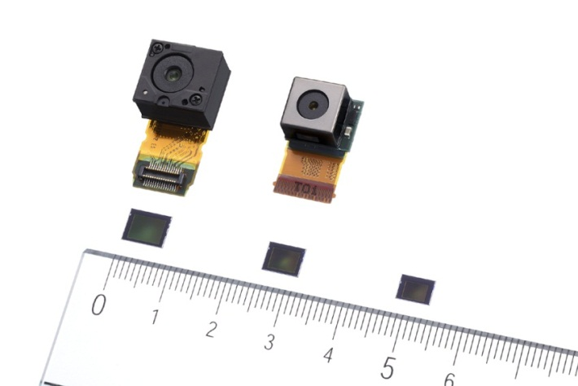
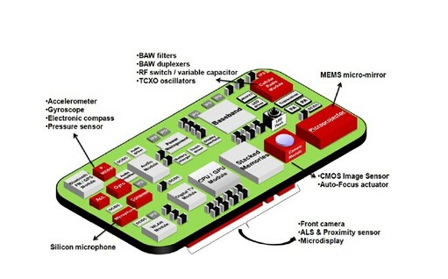
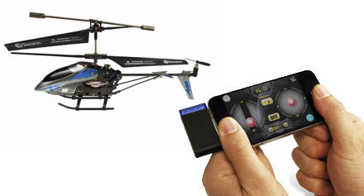
Multi-Modal Data

Slide 19
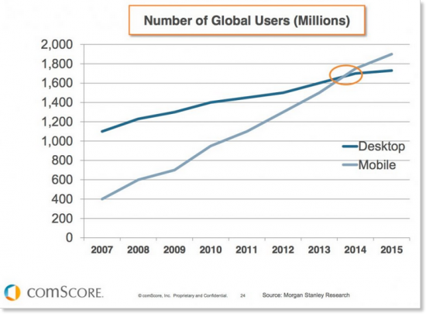
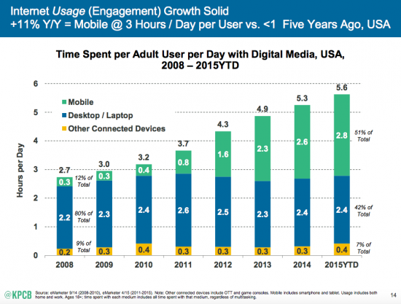
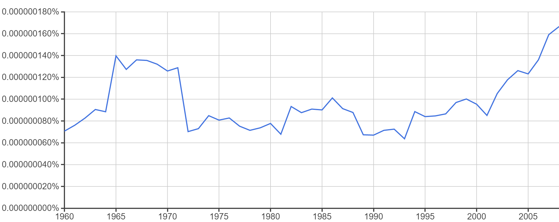
Emerging of Mobile Devices
Mobile devices become popular these years due to their convenience, which generate plenty of behavior data and draw attentions of researchers.
Users of mobile exceed those of PCs in recent years.
Frequency of Mobile Intelligence in the past 50 years. Two fastigiums for traditional mobile invention and intelligent mobile devices, respectively.
Time spent on mobiles per adult in the USA becomes more and more recently.
Statistics come from http://www.smartinsights.com/mobile-marketing
/mobile-marketing-analytics/mobile-marketing-statistics
Notes:
Smart mobile devices become popular nowadays.
The number of mobile users is increasing unexpectedly, which facilitate the user data collection and are valuable for analyzing data from novel applications.
Researchers pay more attentions on mobile intelligence and this is reflected in statistics of research literatures.
We can find that there are obviously increasing trends of researches focusing on mobile intelligence these years.

Slide 20

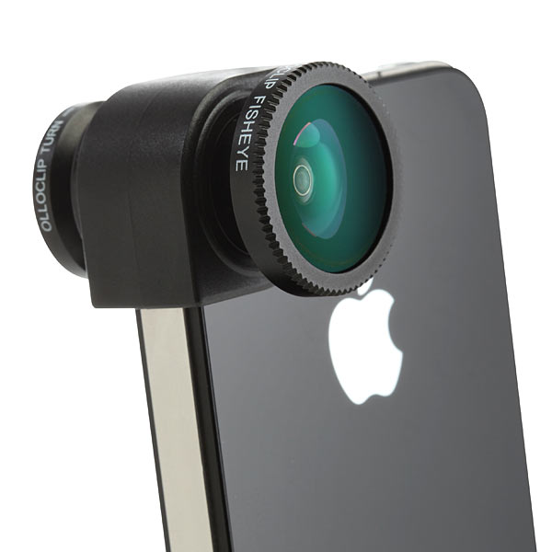



Different Modalities from Sensors
Devices provide different modalities of data for users of objects.
Different sensors on devices.
Sensors offer different kinds of data
User uses different functions of mobiles.
E.g., user can take photos, videos or records.
Data collected from mobiles help decision.
Apps list and GPS tracks can help to understand a user.
How to utilize different modalities of mobile data in a particular task?
Notes:
As we knew that, Mobile devices can collect data from different channels.
E.g., different integrated equipment can provide diverse types of sensing information.
Different functions of mobiles also generate multiple types of data,
and it is true that these data can provide discriminative information for specific tasks.
Yet, How to make full use of these data from different modalities or channels in a particular task is an important direction.

Slide 21
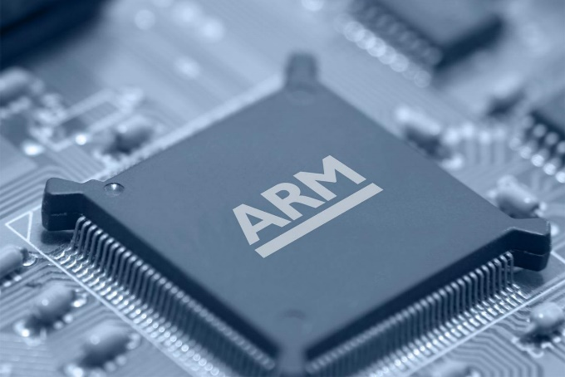
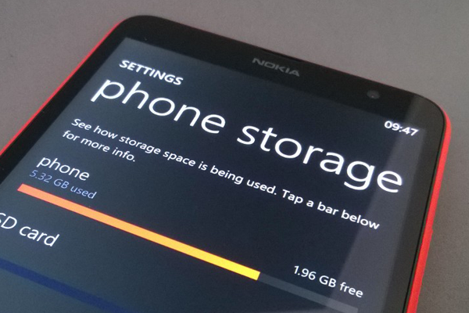
Learning Efficiency in on Chip Devices
Different from PCs, learning models on chip devices are resource-constraint.
Computational/power constraint
Mobiles cannot afford heavy computational burden
Users will not wait for a long time training model
Storage constraint
The trained model size cannot be very large
We need a model which can be trained/tested fast with limited resources
Notes:
It is notable that mobile devices are different from PCs.
1st, computational and power resources are very limited for mobile devices.
2nd, storage is restricted as well. This makes trained model should be with limited size.
Thus, we need a learner, which can be trained/tested fast and occupies small storage.

Slide 22

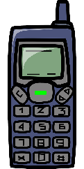
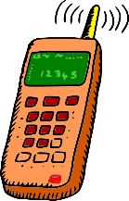
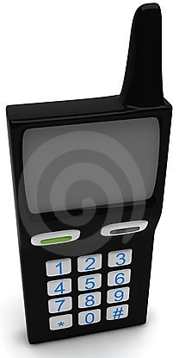
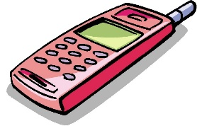
Privacy-Preserving in Multi-Modal
Reflect users’ private information, such as GPS location, photos.
Interactions between service providers and users
Location information
Cellular usage
…
Interactions among users
Messages
Photos
…
When training models utilizing different users’ information, privacy-preserving strategy is necessary.
Notes:
Besides confined on single mobile devices, relationships among multiple mobile devices are also important. Yet, To protect user’s privacy, the individual data on each device cannot be shared in training approach. The private data are including:
the interactions between users and services carriers
or the common communication among users.
So here, a privacy-preserving model is necessary.

Slide 23
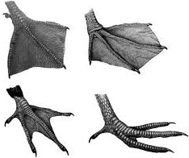
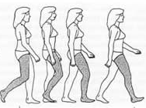
The Strong/Weak Modality
Learning with imbalanced modality in mobile devices
Strong modality: a group of specifically designed features for a task, e.g.:
Finger prints for Identification
Triaxial accelerometer for moving of a phone, etc.
Weak modality: there are two different weak modal
Case I: Lack of information,e.g.：
who can tell me what kinds of birds in
the right?
Case II: With enough information
as well as lots of noise
Notes:
It can be found that in the ID recognition tasks, Information from modalities like finger prints, which can help the task more, is called strong modality. While there are also weak modalities like xxx, xxx in this task. Actually there are two different kinds of weak modalities.
The 1st type is caused by lack of information. This case is really hard problems,
Nevertheless, Another case is with enough information, but is fully filled with more information that is not related to the specific task. Of course, we focus on making full use of the weak modal information in the 2nd case.

Slide 24
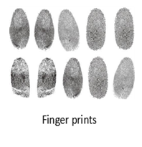
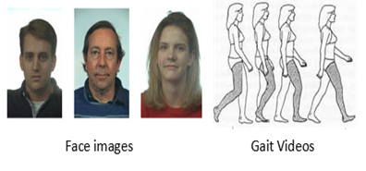
How to Extract More from Weak Modality with the Help of Strong?
Learning with imbalanced modality in mobile devices
Our Goal:
Can we extract more from weak modalities with the help of strong modal information to perform classification?
In training phase：
Strong modal feature
Weak modal feature
Informative feature subspace from weak modalities
+
In testing phase：
Predict with weak modalities only
to avoid the cost of collecting strong modality features
Notes:
So in our first work, our target is to answer the question that can we only use the weak modal features to perform classification, and propose an approach which leverages both the strong and weak modalities, i.e., in the training stage, we want to employ the strong modal features as the auxiliary information to help find the feature subspaces,
while in the testing phase, only the weak modalities are required

Slide 25
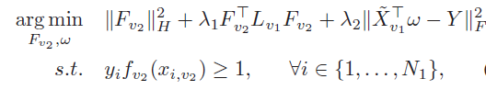
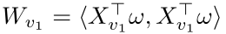
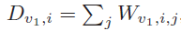
Auxiliary Information Regularized Machine (ARM)
Learning with imbalanced modality in mobile devices
Extract the discriminative weak modal subspace and improve the multi-modal learning performance
The second term is a bridge over strong and weak modalities:
A alignment between strong modal predictors and weak modal similarities;
Laplacian regularizer over weak modalities:
Predictors for weak modalities should be from a relatively weak learner: Least Square is used
Hard margin constraints since predictors on strong modality should be with high accuracy
w is feature extraction matrix for weak modality
Notes:
So we proposed the auxiliary information regularized machine, and formulated it into a opt problem which are with three parts, namely
A strong modality classifier,
With hard margin constraints
A weak projection learner
and the term bridges them. This term can be regarded as a hsic between strong and weak modalities, and can be also treated as a regularization on strong modals.

Slide 26
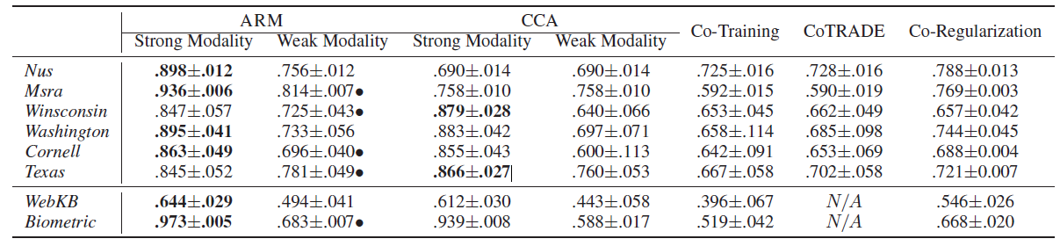
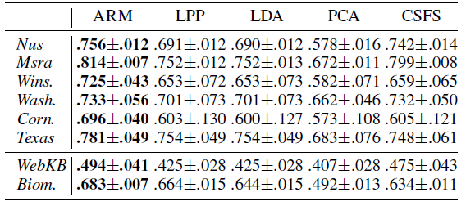
Accuracy Result (Compare with Multi-Modal Learners and Feature Extractors)
Learning with imbalanced modality in mobile devices
Better accuracy on both strong and weak modality
Informative feature subspaces can be extracted with the help of strong modality in ARM
Notes:
In the experiments, we compare ARM with state-of-the-art multi-modal learners and feature extraction methods, ARM can get the best performance on almost all datasets.

Slide 27
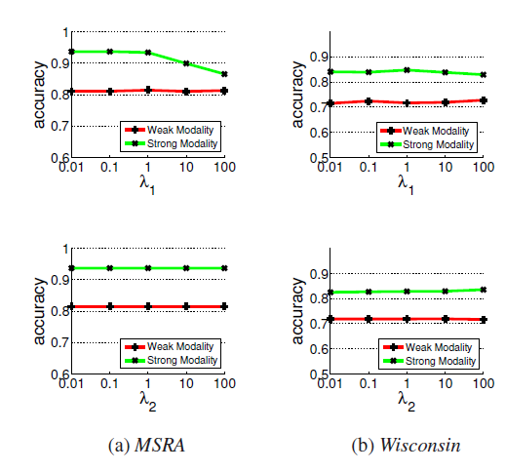
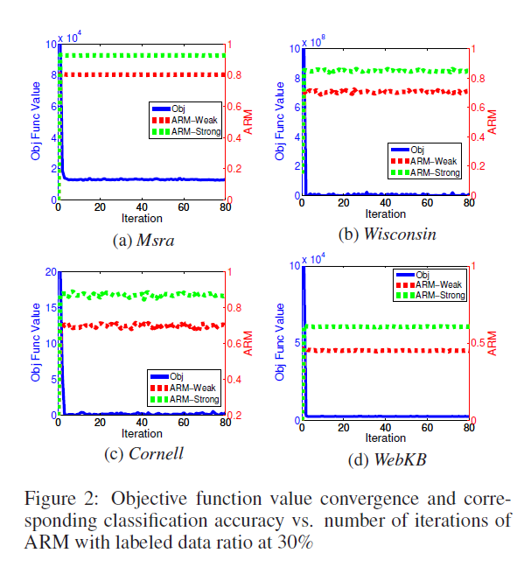
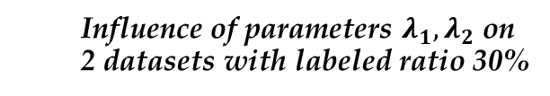
ARM Property Investigations
Learning with imbalanced modality in mobile devices
Influence of parameters $λ_{1},λ_{2}$ on 2 datasets with labeled ratio 30%
Change of objective function value vs. the number of iterations.
Yang Yang, Han-Jia Ye, De-Chuan Zhan and Yuan Jiang. Auxiliary Information Regularized Machine for Multiple Modality Feature Learning. In: Proceedings of the 24th International Joint Conference on Artificial Intelligence (IJCAI’15), Buenos Aires, Argentina, 2015, Page: 1033-1039.
ARM is insensitive to all of the parameters in the framework
ARM converges fast, usually it converges in 5 rounds of iterations
Notes:
Other experiments show stable performance of ARM under different sets of parameters and its optimization property.
This work is accepted by IJCAI 2015.

Slide 28
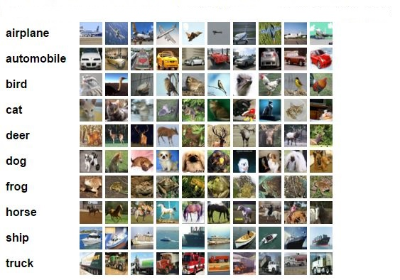
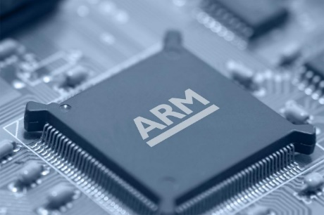
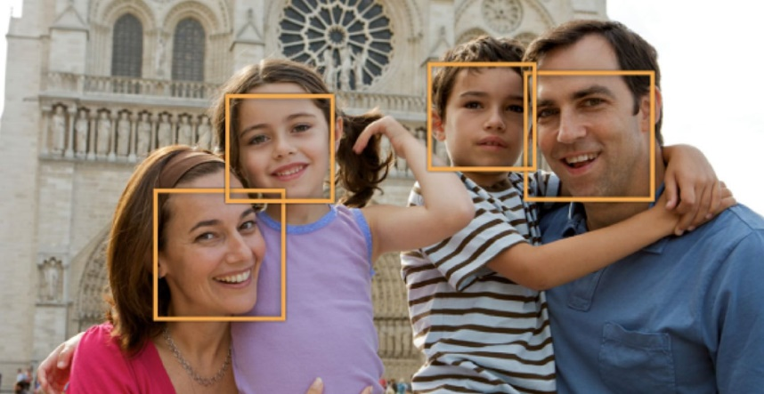
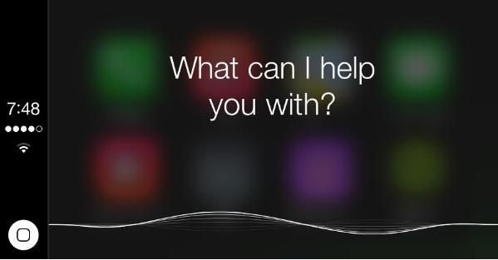
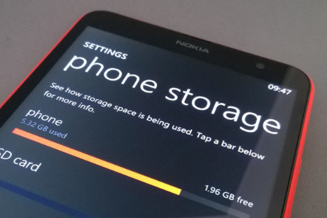
Deep Learning achieves Great Success
Learning with fixed model reuse strategy
Image Classification
Face Detection
Large Training Data
Voice Recognition
Notes:
However, it is also found that although deep models have sufficient representative abilities, training the deep model always need large number of training data, which leads the large computational consumption.

Slide 29
Learning extensively vs. Limited Resources
Learning with fixed model reuse strategy
Large training consumptions:
Including both computational expenses
and large number of labeled examples in training deep models.
Lack adaptability:
One deep model need to be modified or retrained with a mount of data.
Notes:
So now we can have powerful deep models, yet more training efforts need to be paid.
动画出现第二句同时讲：
Besides, deep models also lack adaptabilities, one deep model need to be modified or retrained with amount of data
Both of these issues narrow the applicable range of deep model (这句不是第二点，是总结）

Slide 30

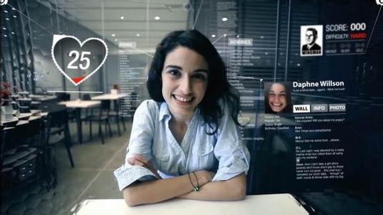
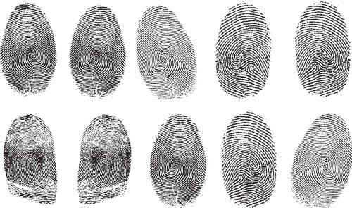
Multi-Modal Features Help
Learning with fixed model reuse strategy
[Li 05; Andelson 14]
Additional Modalities
Image Classification
Surrounding Text
ID recognition
[Tang 15]
Finger prints
Notes:
Nevertheless, for many tasks, there are also lots of mature or industrial models, Or (重音 some sophisticated features for facilitating the concreate tasks.
For examples, in image classification task, one can use pyramid models, Fv features for better performance or even invoke more multi-modal information as surrounding text as well.
This occurs as well on id recognition task, researcher have accumulated a lot of mature face models such as CNN based deep model，besides, more multi-modal biometric features can also be involved.

Slide 31
Extending of Multi-Modal: Fixed Models
Learning with fixed model reuse strategy
Image Classification
Related Fixed Models on other modalities？
ID recognition
Notes:
Nevertheless, for many tasks, there are also lots of mature or industrial models, Or (重音 some sophisticated features for facilitating the concreate tasks.
For examples, in image classification task, one can use pyramid models, Fv features for better performance or even invoke more multi-modal information as surrounding text as well.
This occurs as well on id recognition task, researcher have accumulated a lot of mature face models such as CNN based deep model，besides, more multi-modal biometric features can also be involved.

Slide 32
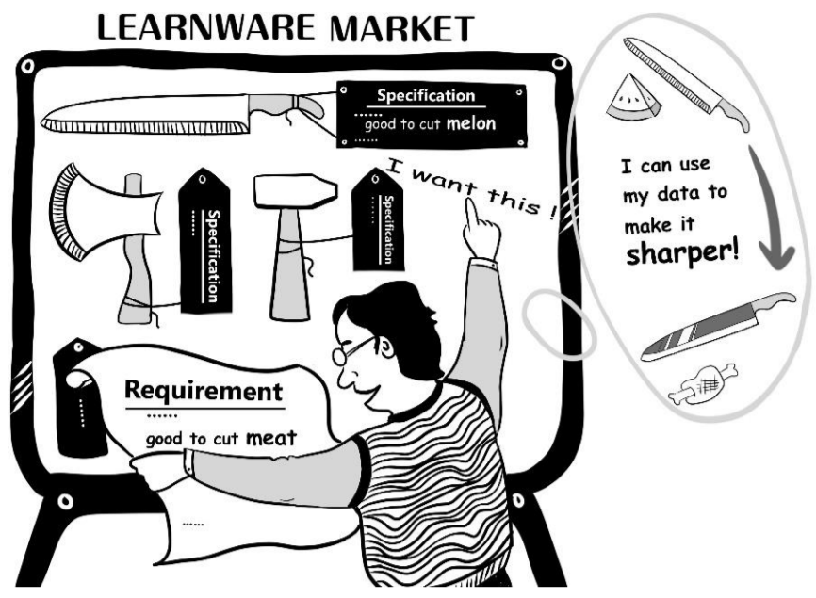
Middle Levels of learners
Learning with fixed model reuse strategy
Transfer Learning [Yang 08; Yang 15;Wei 16]:
middle level for better discrimination
Twice learning [Zhou 02; Yosinski 14]:
middle level for better comprehension
Learnware [Zhou 2016]:
Reusable
Evolvable
Comprehensible
(Reprinted from FCS, vol.10 No.4)
Notes:
Recently, Zhou proposed the learnware framework.
Derived from twice leanring and transfer learning, learnware is based on trained model to construct a new model, rather than building a model from scratch. Besides, learnware emphasis the characteristics of Reusable, Evolvable, and Comprehensible
Our solution can be categorized as a kind of learnware implementations.

Slide 33
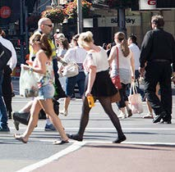
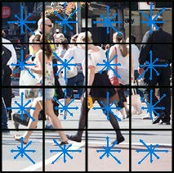
Model Reuse (Non-Learnware Solution)
Learning with fixed model reuse strategy
Twice learning/transfer learning strategies in deep learning for model reuse [Yosinski 14; Ajakan 14]:
$$x_{l_{p}}$$
$$x_{l_{p}}$$
$$x_{l_{1}}$$
$$x_{l_{2}}$$
$$x_{l_{1}}$$
$$x_{l_{2}}$$
y
…
U
…
U
…
…
…
Raw feature x
Sophisticated features z
Raw feature x
Convolutions
Pooling
Fully connected
Convolutions
Pooling
Fully connected
Shortcoming:
Manage different tasks in this two-step training phases;
Induce more chances of error accumulations;
Sweep away the weights contributed by the first step with high probabilities.
$$θ$$
$$θ$$
Notes:
There exists several shortcomings of this indirect solution:
Manage different tasks in this two-step training phases;
Induce more chances of error accumulations;
Sweep away the weights contributed by the first step with high probabilities.
More important, the 2nd step of this kind of model reuse will also resource consuming since lots of examples are required, so this cannot tackle the problem we raised.

Slide 34
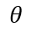
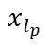
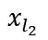
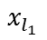
Model Reuse (A Learnware Implementation)
Learning with fixed model reuse strategy
Parallel structure:
y
$$x_{l_{p}}$$
W
$$x_{l_{1}}$$
$$x_{l_{2}}$$
…
…
U
…
…
Raw feature x
Convolutions
Pooling
Fully connected
Sophisticated features z
$$θ$$
Directly arrange the label concepts and pre-obtained model/feature in parallel
Notes:
To overcome the disadvantage of sequence targets replacing design.
We put forward a novel structure together with a new learning strategy which pushes the “information” from fixed model/features to the deep networks in parallel.
In our new structure, we arrange the middle level feature representations and the label concepts in parallel (激光笔圈一下)，thus the weights in the convolution and full connection layers are decided both by the concepts and the middle level features.
Besides, the labels are also determined by the sophisticated features, which is the original model (说这两句的时候激光笔跟随指示）

Slide 35
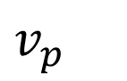
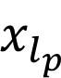
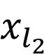
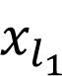


Fixed Model Reuse (con’t)
Learning with fixed model reuse strategy
(a) Weight Propagation (WP)
$$x_{l_{p}}$$
W
$$x_{l_{2}}$$
…
y
$$x_{l_{1}}$$
…
$$v_{p}$$
U
…
x
z
$$θ$$
Update weights U,W,$θ$ backwards (marked with yellow leftwards arrows) to reduce errors on y,z
Notes:
In training phase
First, we Update weights $θ$, U,W backwards (marked with yellow leftwards arrows) to reduce errors on y,z

Slide 36





Fixed Model Reuse (con’t)
Learning with fixed model reuse strategy
(b) Knockdown (KD)
$$x_{l_{p}}$$
W
…
$$x_{l_{1}}$$
$$x_{l_{2}}$$
..
…
U
$$v_{p}$$
x
$$θ$$
z
Randomly eliminate some features z together with changing corresponding: Vp and U (marked with yellow arrows)
Notes:
In knockdown strategy
We randomly eliminate some features z together with changing corresponding: Vp and U (marked with yellow arrows)

Slide 37





Fixed Model Reuse (con’t)
Learning with fixed model reuse strategy
(a’) Weight Propagation after Knockdown (WP/K)
$$x_{l_{p}}$$
W
$$x_{l_{2}}$$
…
y
$$x_{l_{1}}$$
…
$$v_{p}$$
U
…
x
z
$$θ$$
Update weights $θ$, U,W, Vp backwards
Notes:
To harmonize the weights and make the network re-consistent
We updating Vp together as a step

Slide 38
Fixed Model Reuse (con’t)
Learning with fixed model reuse strategy
(a’) Weight Propagation after Knockdown (WP/K)
$$x_{l_{p}}$$
W
$$x_{l_{2}}$$
…
y
$$x_{l_{1}}$$
…
$$v_{p}$$
U
…
x
z
$$θ$$
Notes:
Then we can randomly remove the fixed model/features gradually. As the fixed features removed, those connected weights corresponding to features are also vanished naturally.
Thus, as those connection weights are all vanished in the model. In the test phase, only raw features x are required as inputs for the deep model.
And consequently, No sophisticated features are further desired.

Slide 39

Image Classification
Learning with fixed model reuse strategy
Our approach achieves the 1st performance on 2 multi-class data sets
Notes:
In image classification

Slide 40

Action Recognition
Learning with fixed model reuse strategy
Our approach achieves the 1st performance on 2 multi-class
data sets, and the 2nd best on the rest
Yang Yang, De-Chuan Zhan, Yin Fan, Yuan Jiang, and Zhi-Hua Zhou. Deep Learning for Fixed Model Reuse. In: Proceedings of the 31st AAAI Conference on Artificial Intelligence (AAAI'17), San Francisco, CA. 2017.

Slide 41








Overview: Privacy-Preserving on Multi-Modal data
Privacy-preserving multi-modal learning
Different mobile users with the same task
Contract
View 1
Data 1
The same task
View 2
Data 2
Cooperation
Do not share
feature value
In a cooperation-competition scenario, how to improve performance for each modality on the same task without sharing feature values among modalities?
Academic
Institute, e.g.,
Data 3
View 3
Notes:
In this scenario, there are various sources of data from mobiles, such as GPS information, App Lists.
Different apps or mobiles work on diverse sources of data.
There some restrictions before dealing with the final task. E.g., information only shares between friends or cooperated companies.
Raw features extracted from different modalities should be kept separated from each other.
So here comes the problem of in a cooperation-competition scenario, how to improve performance for each modality on the same task without sharing feature values among modalities?

Slide 42








Rank Consistency on Accumulated Prediction Matrix (APM)
Privacy-preserving multi-modal learning
Modality 1
Modality 2
Modality 3
Modality 4
$$F_{1}$$
$$F_{2}$$
$$F_{3}$$
$$F_{4}$$
Predictions
An opeartor $RC(⋅)$ on Accumulated Prediction Matrix (APM) $F$:
$RC(F)$ reflects the prediction compatibility among views. (Qualitative property)
The expected rank consistency is C − 1 in the ideal case, the degree of freedom of APM (Quantitative property)
OP(
)= ?
Truncated nuclear norm can be acted as a surrogate of the desired operator.
$RC\left(⋅\right)=Rank(F)$
$RC\left(⋅\right) = {\left\|F\right\|}_{r}$
SVD of APM on Reuters
Notes:
We first introduce the basic data structure Accumulated Prediction Matrix. i.e., APM,
which is the concatenation of prediction matrices from each modality.
A suitable operator is needed for APM to improve the modality consistency
From the spectrum plot of APM, it is obvious that there are two Knee points, which are caused by the low rank property of APM, since in the ideal case, when all modalities predict the same, the rank of APM is equal to the freedom degree of classes.
Consequently, we define a rank consistency criterion on APM, using rank to measure prediction consistency, which contains both qualitative and quantitative properties.
Owing to that the ideal rank is known, which is the number of classes minus one, we use truncated nuclear norm to depict the rank operator. which contains both qualitative and quantitative properties.

Slide 43




RANC Framework
Privacy-preserving multi-modal learning
We define the RANC Framework:
Privacy-Preserving：generate classifiers on each single modality
Multi-modal prediction consistncy
rank(
)
$${\left\|F\right\|}_{C−1}$$
On each modality, $F_{k}$ can be solved with proximal gradient method or ADMM splitting variant.
Notes:
Based on the defined rank consistency criterion, we can formulate our RANC framework as follows:
The 1st part focus on the linear classifier training on each individual modality
and the regularizer is used to keep modality prediction consistency.
定义好框架之后，就看如何定义准则的具体描述，如何约束APM的秩

Slide 44












Illustration to RANC
Privacy-preserving multi-modal learning
${Modal}_{1}$ unlabeled data
${Modal}_{2}$ unlabeled data
${Modal}_{3}$ unlabeled data
${Modal}_{4}$ unlabeled data
$$F_{1}$$
$$F_{2}$$
$$F_{3}$$
$$F_{4}$$
Centralization
Distribute Back
Update
Notes:
The whole training process of RANC can be illustrated as follows:
The prediction results from each modality are first centralized, then
after the update
they are distributed back to each modality respectively. During the process, only prediction results are transmitted, which are nearly impossible to recover raw features of each modality, thus the privacy are preserved.

Slide 45




Acceleration: $RANC_{1}$
Privacy-preserving multi-modal learning
For binary problem (C=2) in ideal case RANK(APM) should equal to one
We can enforce rank consistency in a one-vs.-rest manner
Use rank-one approximation which will be fast [P. Berkhin; IM’05]
How to further accelerate the RANC approach?
We first consider binary case together with one-vs.-rest strategy.
Rank 1 approximation with learned bias
Notes:
Though preivous two solutions can solve the subproblem effectively, in practice how do we further...
It just to get the largest eigen-vector of a matrix, which can be computed fast by mature efficient toolboxs
为什么要做RANC1，为了加速

Slide 46


Comparing with Fusion Methods
Privacy-preserving multi-modal learning
Pre-fusion: Access feature from all views to construct kernels
Late Fusion: Cannot help improve modality-specific classifier
Comparison on all datasets
We can get best results on most datasets
$t$-test results: almost Win on all datasets
Notes:
The first group of columns is classfication accuracy of our methods, and the following groups are compared methods,
which are with privacy or other problems. RANC can achieve better performance compared with other methods.
Which shows considering the centerization is reasonable in RANC_ADMM

Slide 47


Disagreement-Based Comparison
Privacy-preserving multi-modal learning
2-view Datasets
Deal with 2 views and rely on view independency
Good results
Accuracy of each view
View ensemble results
$t$-test results
Han-Jia Ye, De-Chuan Zhan, Yuan Miao, Yuan Jiang and Zhi-Hua Zhou. Rank Consistency based Multi-View Learning: A Privacy-Preserving Approach. In: Proceedings of the 24th ACM International Conference on Information and Knowledge Management (CIKM’15), Melbourne, Australia, 2015, Page: 991-1000.
Notes:
Co-training based methods only work on two views, however,
RANC can also get better results when the number of modalities is small.
The paper about RANC framework is accepted by CIKM 2015.

Slide 48





Privacy-Preserving with Partial Modality
Users can select to supply some of their mobile usage information to system suppliers. Therefore, extracted modalities are not complete, i.e., they have missing entries.
App List
GPS Information
Favorite music
Messages
User 1
User 2
User 3
User 4
Notes:
Besides, user profiles can be depicted by different mobile functions, such as use’s APP list and favorite music. User information privacy is necessary in this scenario, which means user specific information cannot be inferred from data used by models. In addition, not all users are willing to provide all their private information to the APP or models, which results in the missing of modalities.
Consequently, Partial Modality Learning (PML) issues coming from Privacy-Preserving strategy should be one of my future research interests.
Based on the generative process of my isMets method, we can recover/re-generate missing values of each modality in a Bayesian style. The inference process can be solved in a stochastic process, which is efficient and consistent with the requirement on mobile devices. Prediction results on unlabeled data can be used as a bridge among modalities and can be implemented by Bayesian regularization technology.
the task can be improved in a PML and privacy-preserving situation.
Some theoretical guarantees from differential privacy area are recently proposed papers.

Slide 49
THANKS

